Slide 1
Population Growth

Slide 2
Population Density
It is expressed as the number of individuals of the population per unit area or per unit volume.
Factors affecting population size
Birth rate or Natality.
Death rate or Mortality.
Immigration.
Emigration.

Slide 3
Population Growth ( Birth : Death )

Slide 4
Causes of rapid population growth
The rapid population growth is due to decrease in death rate and increase in birth rate.
The availability of antibiotics, immunisation, increased food production, clean water and air decreases the famine- related deaths and infant mortality.

Slide 5
Characteristics of population growth
Exponential growth
Doubling Time
Time required for a population to double its size.
Td ( Doubling Time ) = 70 / r
r = annual growth rate.
Infant mortality rate.
Total fertility rates.
Average no of children delivered by women in her life time.
Replacement level.
Male – Female ratio.
Demographic transition.

Slide 6
Problems of population growth
Increasing demands for food and natural resources.
Inadequate housing and health services.
Loss of agricultural lands.
Unemployment and socio-political unrest.
Environmental pollution.

Slide 7
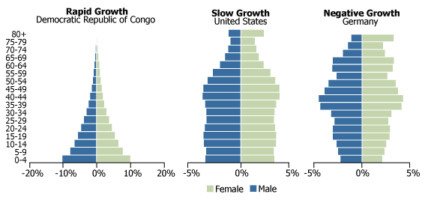
Shapes of Population Growth

Slide 8
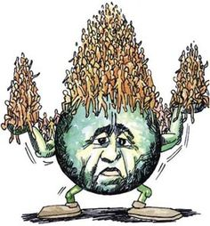
Population Explosion

Slide 9
Population Explosion
Rapid Growth of population is known as population explosion.
Abnormal Growth of population.

Slide 10
Effects of population explosion
Demand for food.
Housing Problem.
Pollution.
Scarcity of natural resources.
Economic Implications.

